Slide 1


Project Report
Summer Internship (UNT)
Health Informatics
Agent-Based AI System for Melanoma Classification
BY
SURAM JAHNAVI REDDY
(229X1A3392)

Slide 2
Introduction
Melanoma is a critical form of skin cancer that requires rapid and accurate diagnosis. This project focuses on developing a modular, agent-based AI system that integrates visual and language models to enhance the classification of dermoscopic images.

Slide 3
Background
Skin cancer, particularly melanoma, is among the most prevalent cancer types worldwide. Early detection significantly improves patient prognoses. While dermoscopic imaging aids diagnosis, manual evaluation is slow and subjective.

Slide 4
Objective
To create an AI system that classifies dermoscopic images as either melanoma or benign. Utilization of both visual models (ViT) and language models (CLIP, GIT) for improved accuracy and interpretability.

Slide 5
Methodology
A Triage Agent using ViT assigns malignancy scores to images. Decision Agents (CLIP, GIT) provide explanatory outputs and malignancy estimates. Evaluation metrics included sensitivity, specificity, and classification accuracy across varying thresholds.

Slide 6
System Design
Integration of various AI models into a unified diagnostic pipeline. Use of 150 images from the HAM10000 dataset for initial experiments. Ground truth established through well-documented metadata.

Slide 7
Experimental Design
The project was conducted over six weeks with specified weekly objectives. Activities included model exploration, validation, and performance evaluation. A total of two systems were compared: System S1 (ViT-only) and System S2 (ViT with CLIP/GIT).

Slide 8
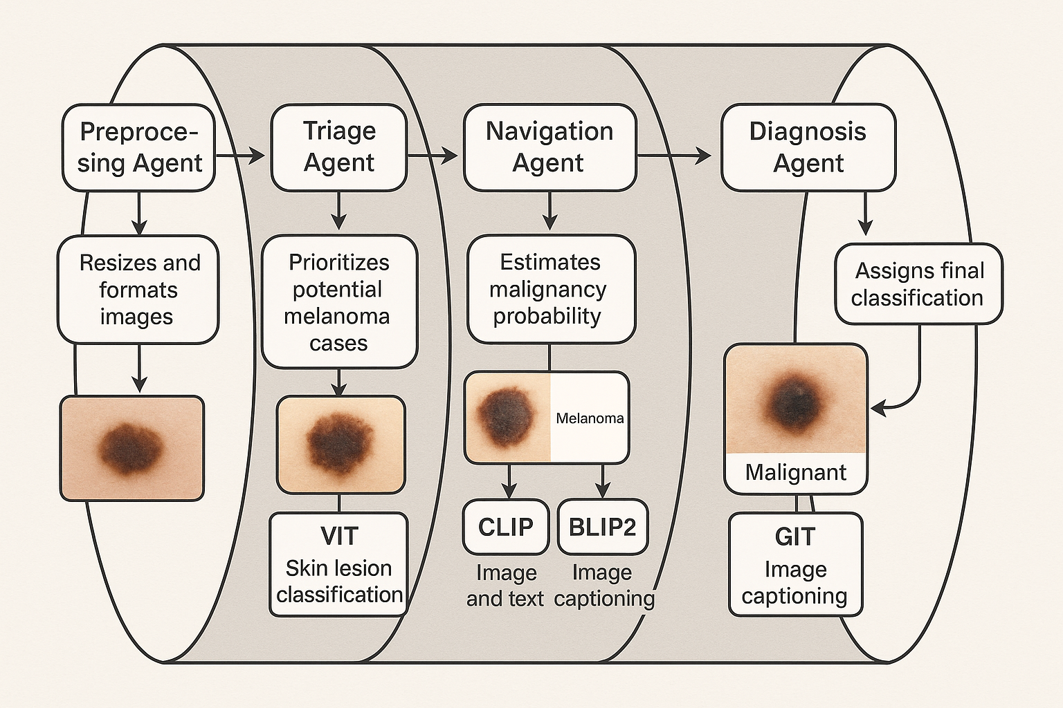
⚙️ Models Used
Model | Role | Type
ViT | Image Classification | Vision Transformer
BLIP2 | Image-to-Text Explanation | Vision-Language Transformer
GIT | Image Captioning | Vision-Language Transformer
CLIP | Classification + Explanation | Image–Text Matching Model

Slide 9
🗓️ Weekly Summary
Week | Objective | Key Activities | Output / Outcome
Week 1 | Select a ViT model for skin lesion classification | Chose ViT from Hugging Face Downloaded 150 HAM10000 images Built basic Colab pipeline | ViT classified lesions with confidence scores Shared notebook with supervisors
Week 2 | Validate model using cross-validation and ROC | Labeled images as melanoma vs. non-melanoma Applied 10-fold CV Calculated AUC, plotted ROC | Reported average AUC ROC confirmed ViT’s effectiveness
Week 3 | Develop multi-agent pipeline for lesion analysis | Created preprocessing, triage, and navigation agents Integrated full agent pipeline Explored V2T models | Operational agent pipeline Identified suitable V2T models
Week 4 | Integrate V2T models with ViT for classification | Designed prompt for V2T Ran BLIP2 and GIT on 10 images Compiled results into CSV | Generated malignancy scores and explanations Assessed feasibility of multi-model fusion
Week 5 | Compare ViT, CLIP, GIT outputs with ground truth | Ran ViT, CLIP, GIT on 150 images Logged predictions vs. true labels Analyzed output quality | Final CSV created CLIP matched labels well GIT outputs less reliable
Week 6 | Compare S1 (ViT-only) and S2 (ViT+CLIP+GIT) systems across thresholds and resolve agent disagreement | Computed TP, TN, FP, FN, Sensitivity, Specificity for multiple thresholds Visualized results Proposed decision rule for CLIP-GIT disagreement | Found S2 improves sensitivity; finalized CSV + plots Proposed OR-rule for agent conflict resolution

Slide 10
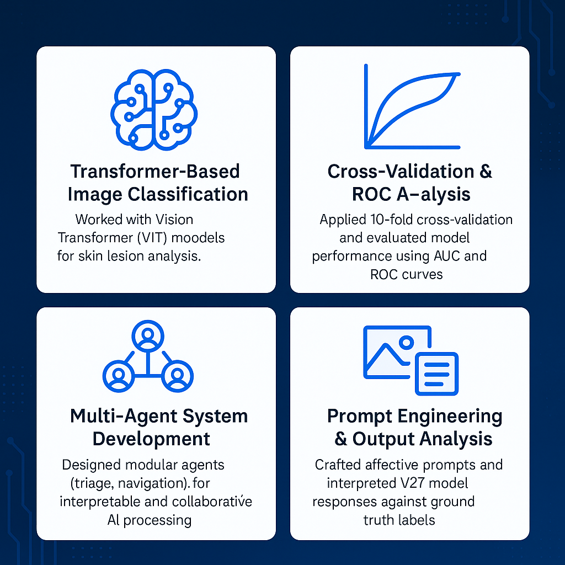
🎓 Skills Gained
Transformer-Based Image Classification Worked with Vision Transformer (ViT) models for skin lesion analysis.
Cross-Validation & ROC Analysis Applied 10-fold cross-validation and evaluated model performance using AUC and ROC curves.
Multi-Agent System Development Designed modular agents (triage, navigation) for interpretable and collaborative AI processing.
Vision-to-Text Model Integration Integrated models like CLIP and GIT to generate textual explanations from dermoscopic images.
Prompt Engineering & Output Analysis Crafted effective prompts and interpreted V2T model responses against ground truth labels.

Slide 11

Results
System S1 showed high specificity and moderate sensitivity across all triage thresholds. System S2 exhibited lower overall performance, with significant disparities in sensitivity and false positive rates. The general-purpose models struggled with domain-specific interpretation.

Slide 12
Discussion
The introduction of multi-agent models aimed to improve interpretability but fell short in performance. The findings highlight the challenges of adapting non-specialized models to specialized medical applications. Further improvements require domain-specific training and better alignment of outputs with clinical realities.

Slide 13
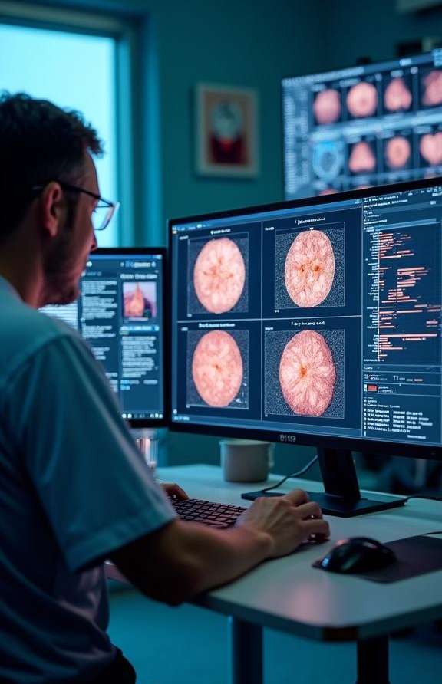
Conclusions
This project demonstrates the potential of modular, agent-based frameworks for enhancing diagnostic accuracy in melanoma classification. While results were mixed, they provide essential insights into the necessity of fine-tuning AI models for clinical application and the importance of transparency in AI diagnostics.

Slide 14
References
ISIC and HAM10000 datasets
PathFinder framework for inspiration in AI model design

Slide 15
Thank you!

